Slide 1

Block coding Developer
Session - 32
Arithmetic Operators - 2

Slide 2

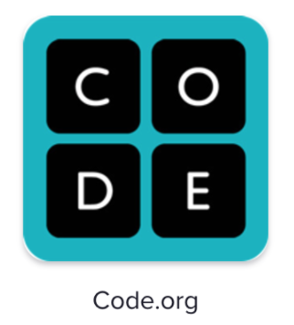
Recall…
What we have learnt in last session
What challenges you are facing

Slide 3
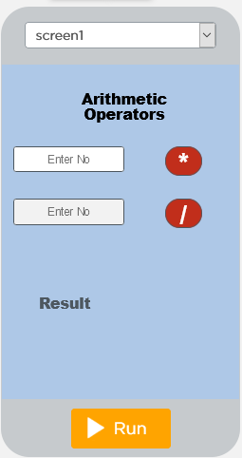
Arithmetic Operators - 2
We will Learn today:
What is Multiplication?
What is Division?
Operation in App Lab

Slide 4
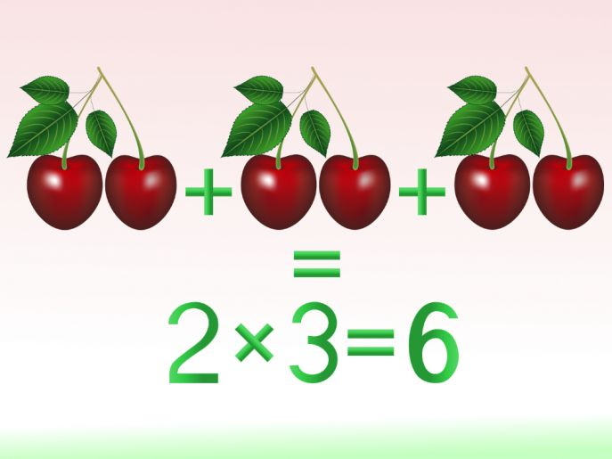
What is Multiplication?
Multiplication is when you take one number and add it together a number of times

Slide 5
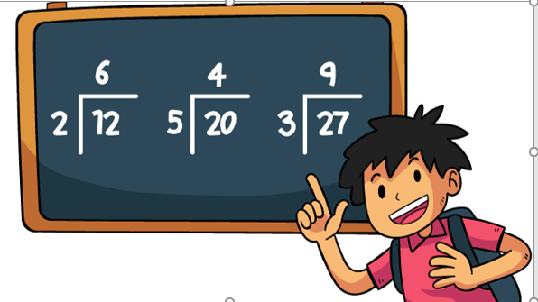
What is Division?
Division is breaking a number up into an equal number of parts.

Slide 6
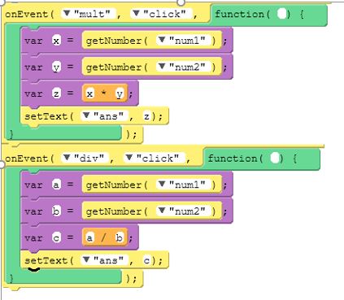
Multiplication and Division…
Calculating the multiplication or division of two number using a App Lab
First define two variable
First Value to be added
Second Value to be added

Slide 7
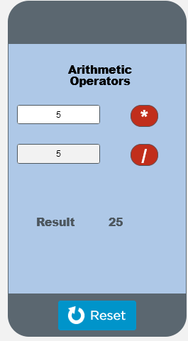
Output – Multiplication…

Slide 8
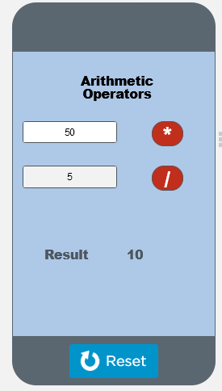
Output – Division…

Slide 9

Summary…
Multiplication in App Lab
Division in App Lab

Slide 10
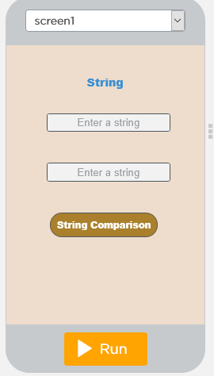
Next Session…
What is a String?
What is String Comparison?
How to compare two strings?

